Slide 1
Population structure, admixture
and changes in population size

Slide 2
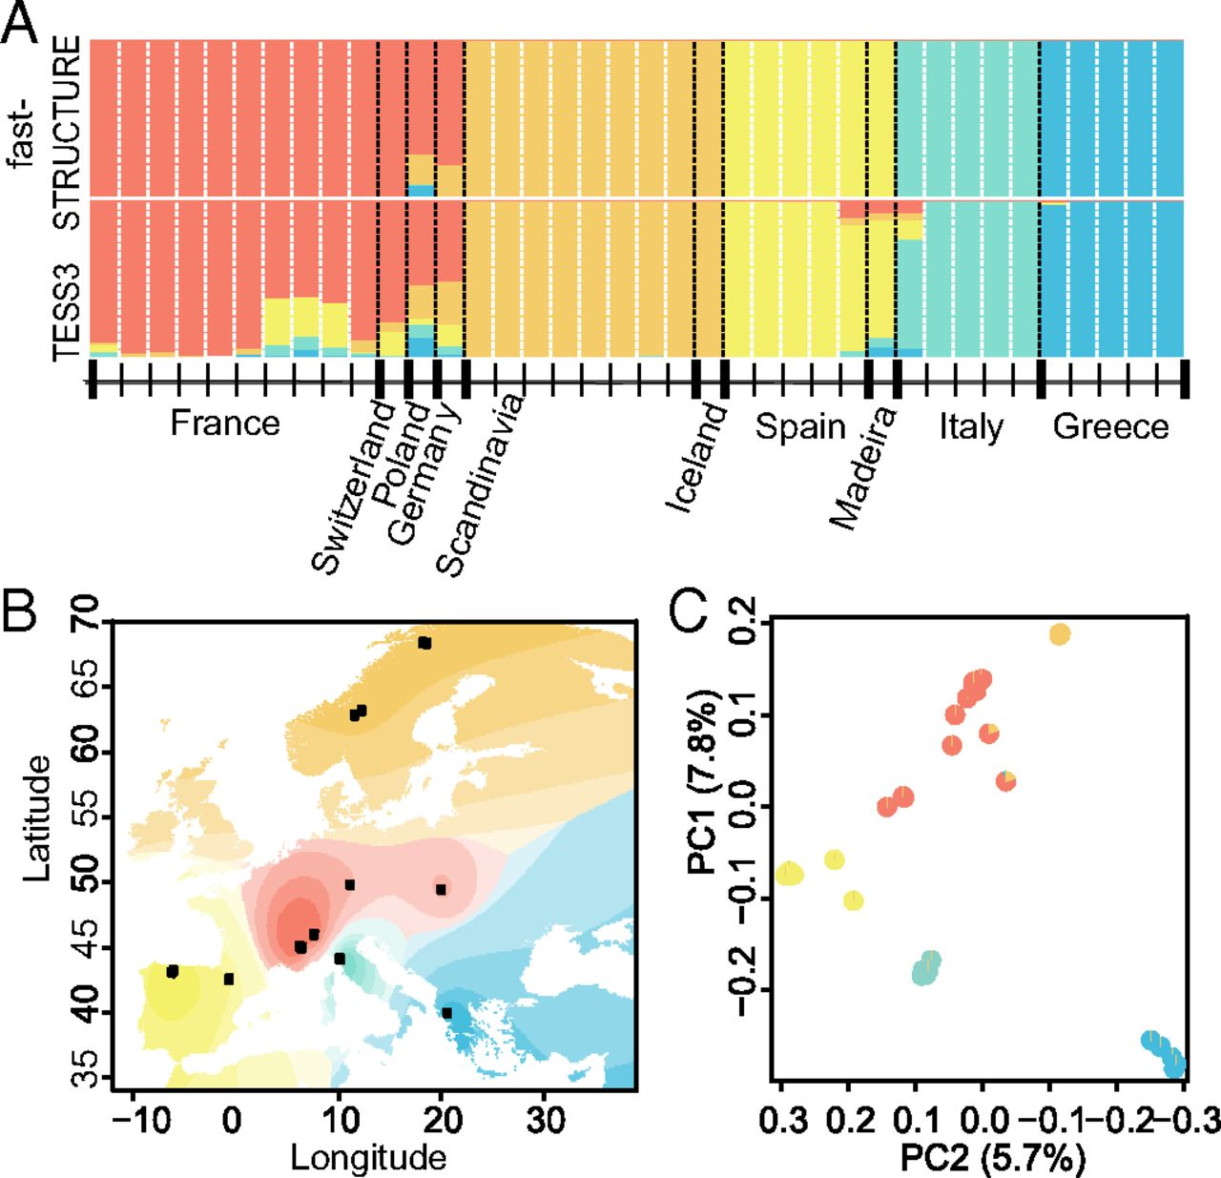
Geographic structure in
European Arabis alpina
Benjamin Laenen et al.
PNAS 2018;115:4:816-821
Notes:
Bayesian clustering analysis supports a strong geographic component to population structure in European A. alpina. (A) Ancestry proportions for K = 5 clusters correspond closely to geographical sampling locations. (B) Geographic interpolation of genetic structure across Europe based on TESS3 results for K = 5. (C) PCA of genetic data, with pie charts showing ancestry proportions for K = 5 and colors indicating geographic origin.

Slide 3
Today
Genetic structure of populations
Hardy-Weinberg Equilibrium
Genetic variation in space and time
Variation in natural populations, Wright’s Fixation Index (F_{ST})
Other methods to measure population structure/gene flow

Slide 4
A
a

Slide 5
Allele frequencies
N_{A}
7
N_{a}
₁₃
f_{A} =
=
or f_{a} = =
2N
2*10
2N
2*10
A
a

Slide 6
Allele frequencies
N_{A}
7
N_{a}
₁₃
f_{A} =
=
or f_{a} = =
2N
2*10
2N
2*10
Genotype frequencies
N_{AA}
₁
A
a
f_{AA} =
=
2N
10
NA_{a}
₅
fA_{a} = =
2N
10
N_{aa}
₄
f_{aa} = =
2N
10

Slide 7
Allele frequencies
N_{A}
7
N_{a}
₁₃
f_{A} =
=
or f_{a} = =
2N
2*10
2N
2*10
K-allelic loci
f_{i} = f_{ii} + Σ f_{ij}/2
Genotype frequencies
N_{AA}
₁
A
a
f_{AA} =
=
2N
10
NA_{a}
₅
fA_{a} = =
fA_{a} = Heterozygosity
1 - fA_{a} = Homozygosity
= fAA + f_{aa}
2N
10
N_{aa}
₄
f_{aa} = =
2N
10

Slide 8
Allele frequencies
N_{A}
7
N_{a}
₁₃
f_{A} =
=
or f_{a} = =
2N
2*10
2N
2*10
K-allelic loci
f_{i} = f_{ii} + Σ f_{ij}/2
Genotype frequencies
N_{AA}
₁
A
a
f_{AA} =
=
2N
10
NA_{a}
₅
fA_{a} = =
fA_{a} = Heterozygosity
1 - fA_{a} = Homozygosity
= fAA + f_{aa}
2N
10
N_{aa}
₄
f_{aa} = =
2N
10
2N_{AA} + N_{Aa}
You can also calculate allele frequencies by:
f_{A} =
2N

Slide 9
Hardy-Weinberg:
Explains how Mendelian segregation influences allelic and genotypic frequencies in a population

Slide 10
Hardy-Weinberg:
Explains how Mendelian segregation influences allelic and genotypic frequencies in a population
Assumptions:
Population is infinitely large, to avoid effects of genetic drift
(= change in genetic frequency due to chance)
Mating is random (with regard to traits under study)
No natural selection (for traits under study)
No mutation
No migration

Slide 11
Hardy-Weinberg law:
If assumptions are met, population will be in genetic equilibrium
Two expected predictions:
Allele frequencies do not change over generations.
After one generation of random mating, genotypic frequencies will remain in the following proportions:

Slide 12
Hardy-Weinberg law:
If assumptions are met, population will be in genetic equilibrium
Two expected predictions:
Allele frequencies do not change over generations.
After one generation of random mating, genotypic frequencies will remain in the following proportions:
p² (frequency of AA)
2pq (frequency of Aa)
q² (frequency of aa)
p = allelic frequency of A
q = allelic frequency of a
p² + 2pq + q² = 1
f_{A}² + 2f_{A}f_{a} + f_{a}² = (f_{A} + f_{a})² = 1

Slide 13
Basis of the Hardy-Weinberg
Hardy-Weinberg state: p² + 2pq + q² = 1 ~ at equilibrium
Zygotes form by random combinations of alleles, in proportion to the abundance of the alleles in the population.
If f(p) = 0.5 and f(q) = 0.5, outcome is as follows:
When population is at equilibrium:
p² + 2pq + q² = 1
 | A(p) | a(q)
A(p) | AA(p²) 0.5 x 0.5 = 0.25 | Aa(pq) 0.5 x 0.5 = 0.25
a(q) | Aa(pq) 0.5 x 0.5 = 0.25 | aa(q²) 0.5 x 0.5 = 0.25

Slide 14
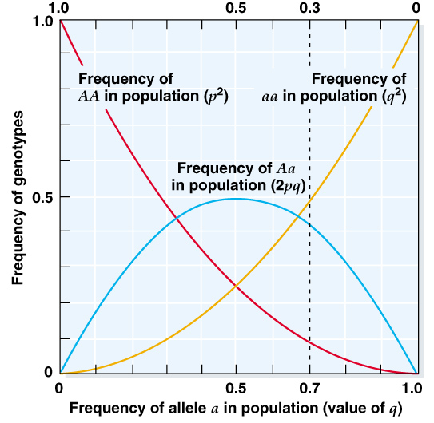
Max. heterozygosity
p = q = 0.5

Slide 15
Assumptions of Hardy-Weinberg :
Population is infinitely large
Assumption is unrealistic
Large populations are mathematically similar to infinitely large populations
Finite populations with rare mutations, rare migrants, and weak selection generally fit Hardy-Weinberg proportions

Slide 16
Mating is random
Few organisms mate randomly for all traits or loci
Hardy-Weinberg applies to any locus for which mating occurs randomly, even if mating is non-random for other loci
This works because different loci assort independently due to recombination

Slide 17
No natural selection
No mutation
No migration
Gene pool must be closed to the addition/subtraction of new alleles
Selection subtract alleles or cause some alleles to increase in frequency
Mutation adds variation (generates novel alleles)
Effects of mutation can be accommodated with a model (e.g., infinite alleles model)
Migration can add or subtract variation depending on which alleles migrants carry and whether they immigrate or emigrate

Slide 18
Testing Hardy-Weinberg assumptions:
Data from real populations rarely match Hardy-Weinberg proportions
Test observed and expected proportions with a goodness of fit (GF) test such as a chi-square test.
If deviation is larger than expected, begin to determine which assumptions are violated (this is where the real work of population genetics begins).
Factors that contribute to non-equilibrium:
Population differentiation (through drift and mutation)
Migration
Fluctuations in population size
Selection

Slide 19
Mutations change allele frequencies
Pop 1
Pop 1 (next generation)
Mutation

Slide 20
Drift also changes allele frequencies
(sampling error)
Drift occurs in finite populations, even with completely random mating, and leads to changes in both genotype and allele frequencies.
http://rosetta.ahmedmoustafa.io/drift/

Slide 21
Drift changes allele frequencies
(sampling error)
http://rosetta.ahmedmoustafa.io/drift/

Slide 22
Drift changes allele frequencies
(sampling error)
http://rosetta.ahmedmoustafa.io/drift/

Slide 23
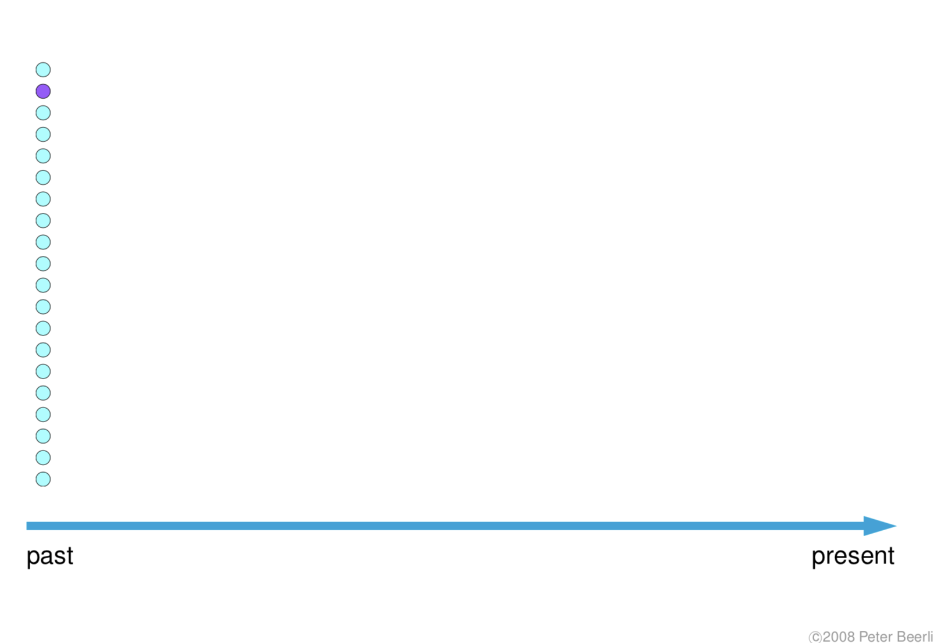
Mutation and Drift change allele frequencies

Slide 24
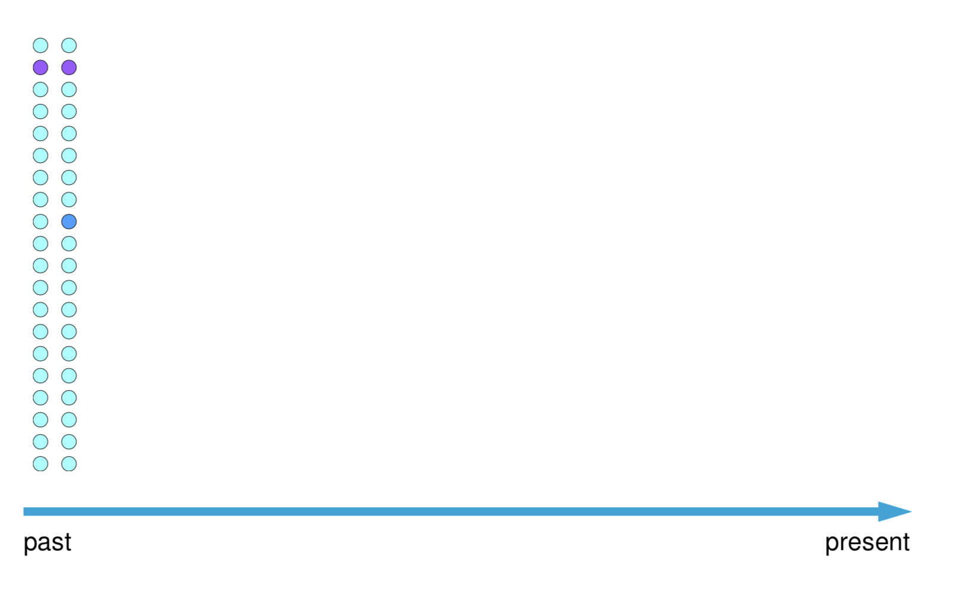
Mutation and Drift change allele frequencies

Slide 25
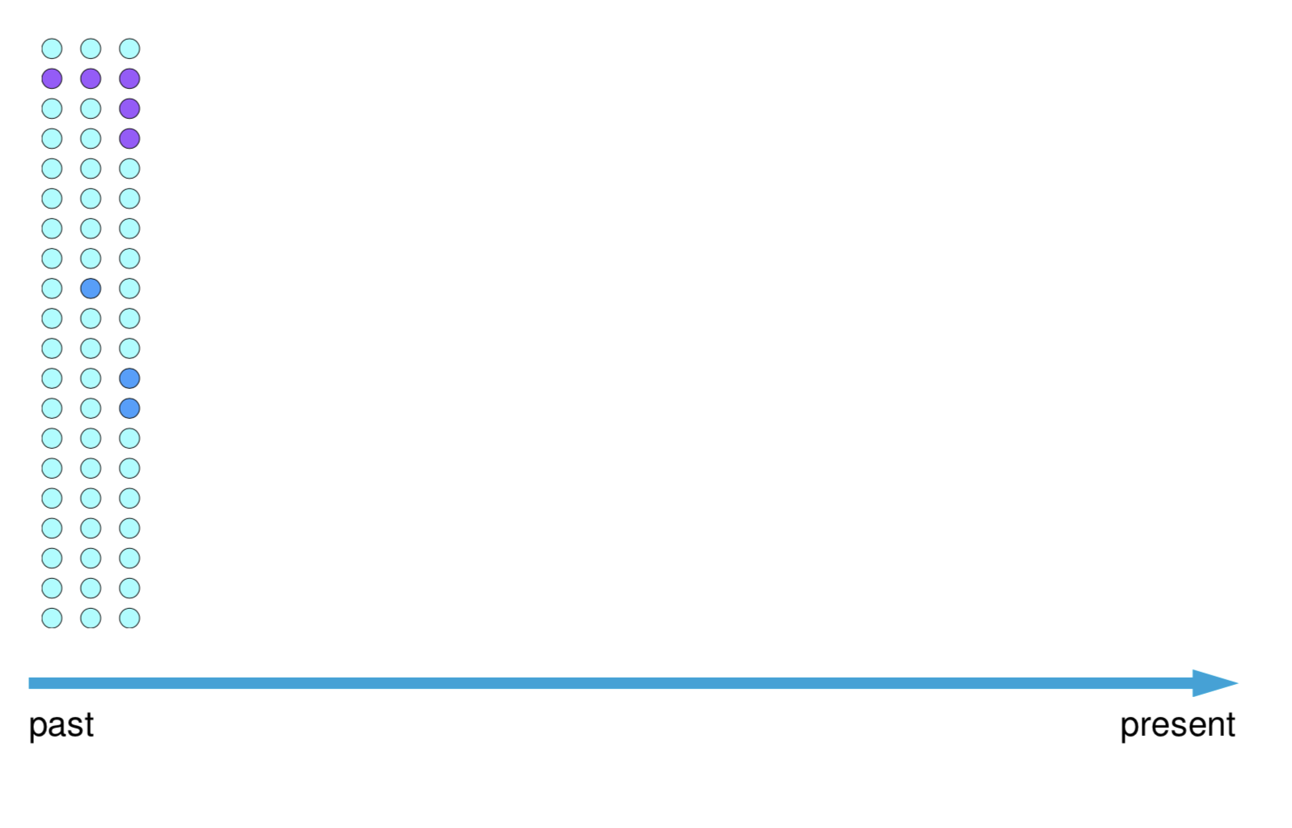
Mutation and Drift change allele frequencies

Slide 26
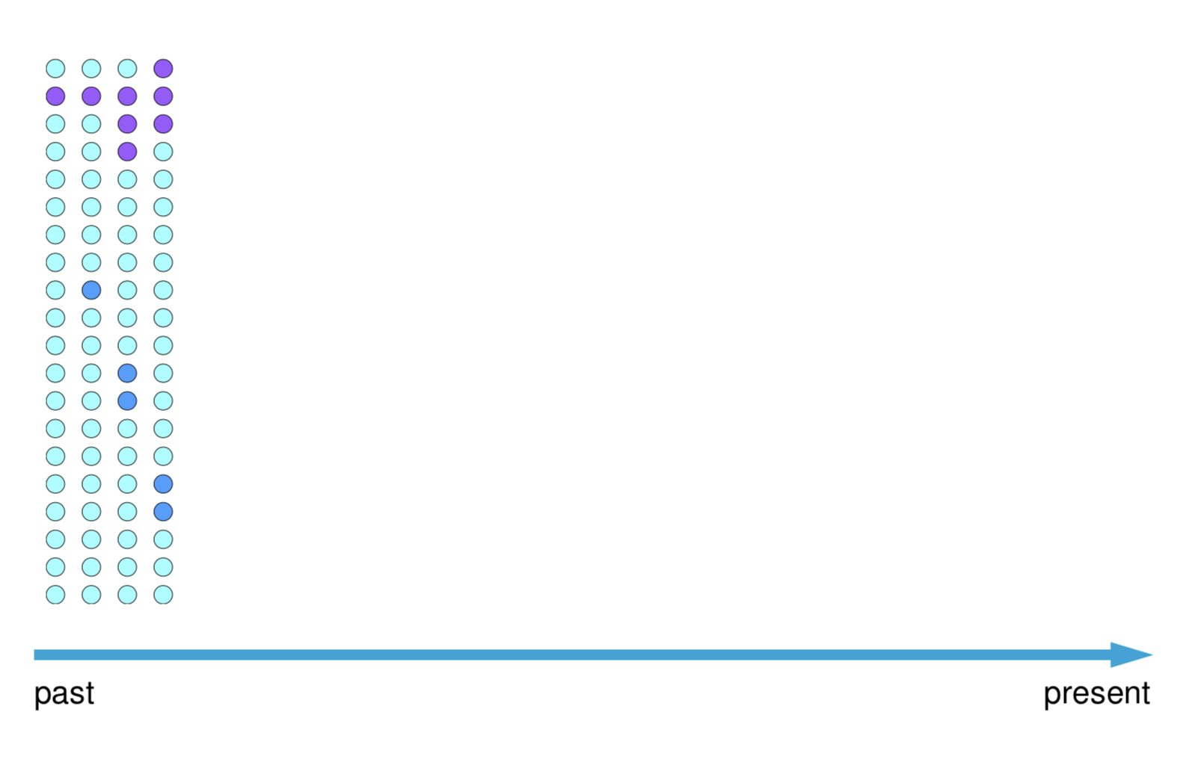
Mutation and Drift change allele frequencies

Slide 27
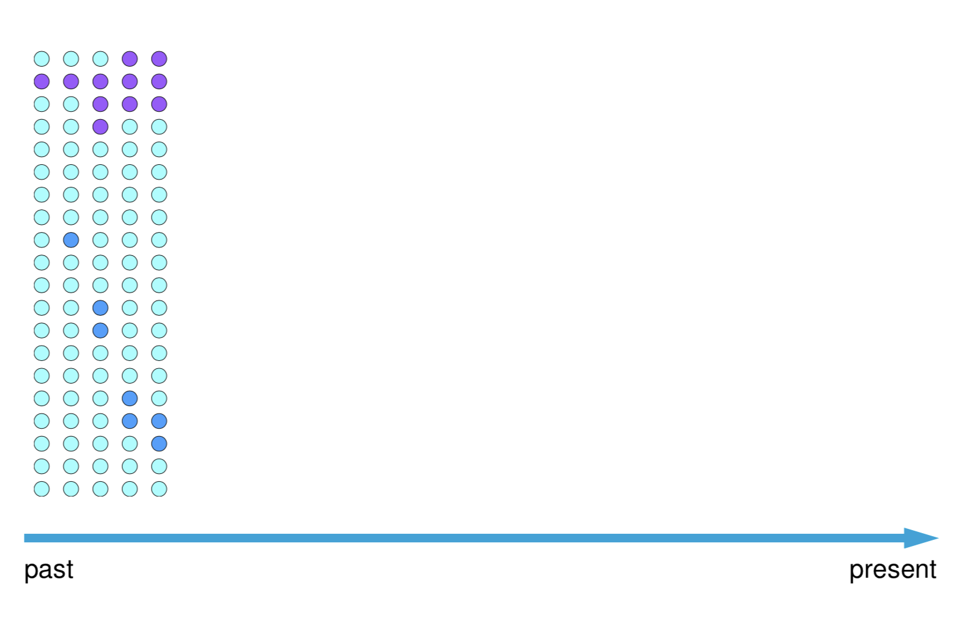
Mutation and Drift change allele frequencies

Slide 28
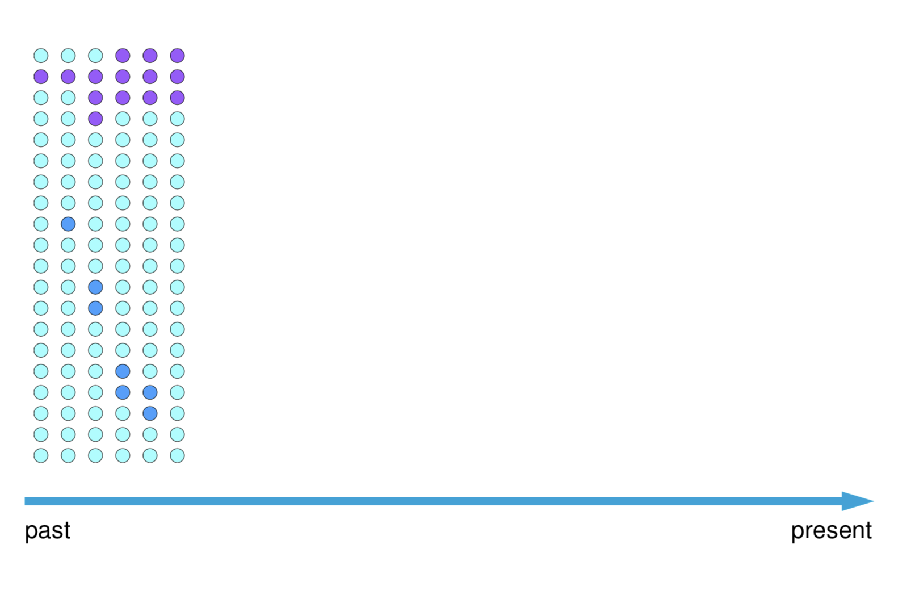
Mutation and Drift change allele frequencies

Slide 29
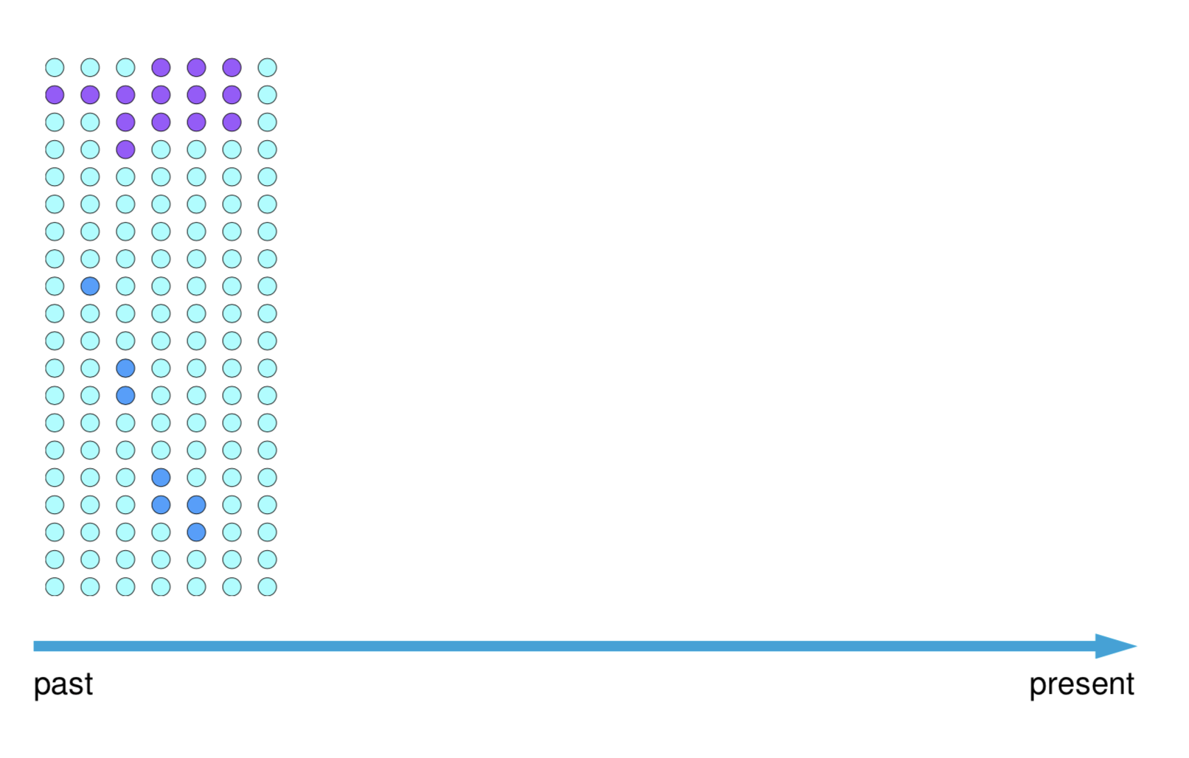
Mutation and Drift change allele frequencies

Slide 30
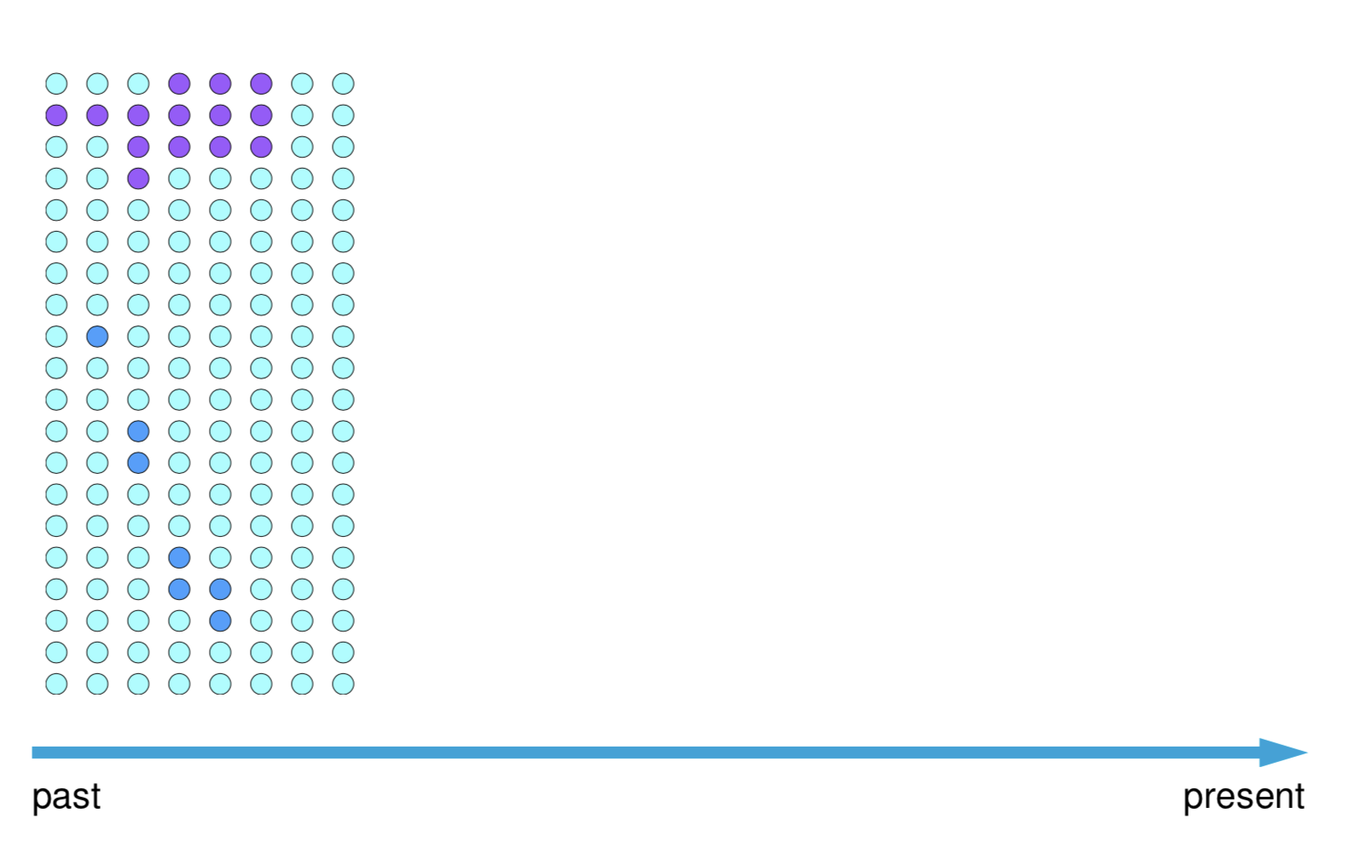
Mutation and Drift change allele frequencies

Slide 31
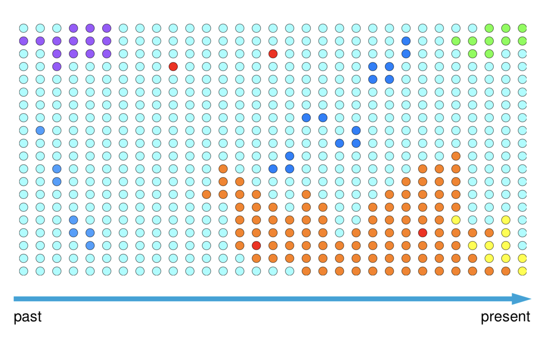
Mutation and Drift change allele frequencies
https://phytools.shinyapps.io/drift-selection/

Slide 32
https://phytools.shinyapps.io/drift-selection/

Slide 33
Gene flow (migration) also changes allele frequencies
Migration refers to the movement of some organisms (or their gametes) among subpopulations and subsequent breeding, also referred to as gene flow, or admixture. Migration acts to homogenize populations, or reduce differences between populations

Slide 34
Variations in population size also changes allele frequencies

Slide 35

Balance between
Drift Migration
http://www.cienciaonline.com/2007/07/23/accion-reaccion-%C2%BFse-entiende/

Slide 36
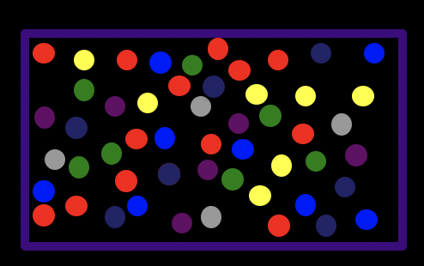
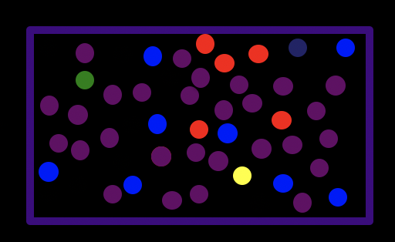
Balance between
Drift Migration
Genetic structure
(subpopulations)
Genetic homogeneity
Panmixia (single population
http://www.cienciaonline.com/2007/07/23/accion-reaccion-%C2%BFse-entiende/

Slide 37
https://phytools.shinyapps.io/drift-selection/

Slide 38
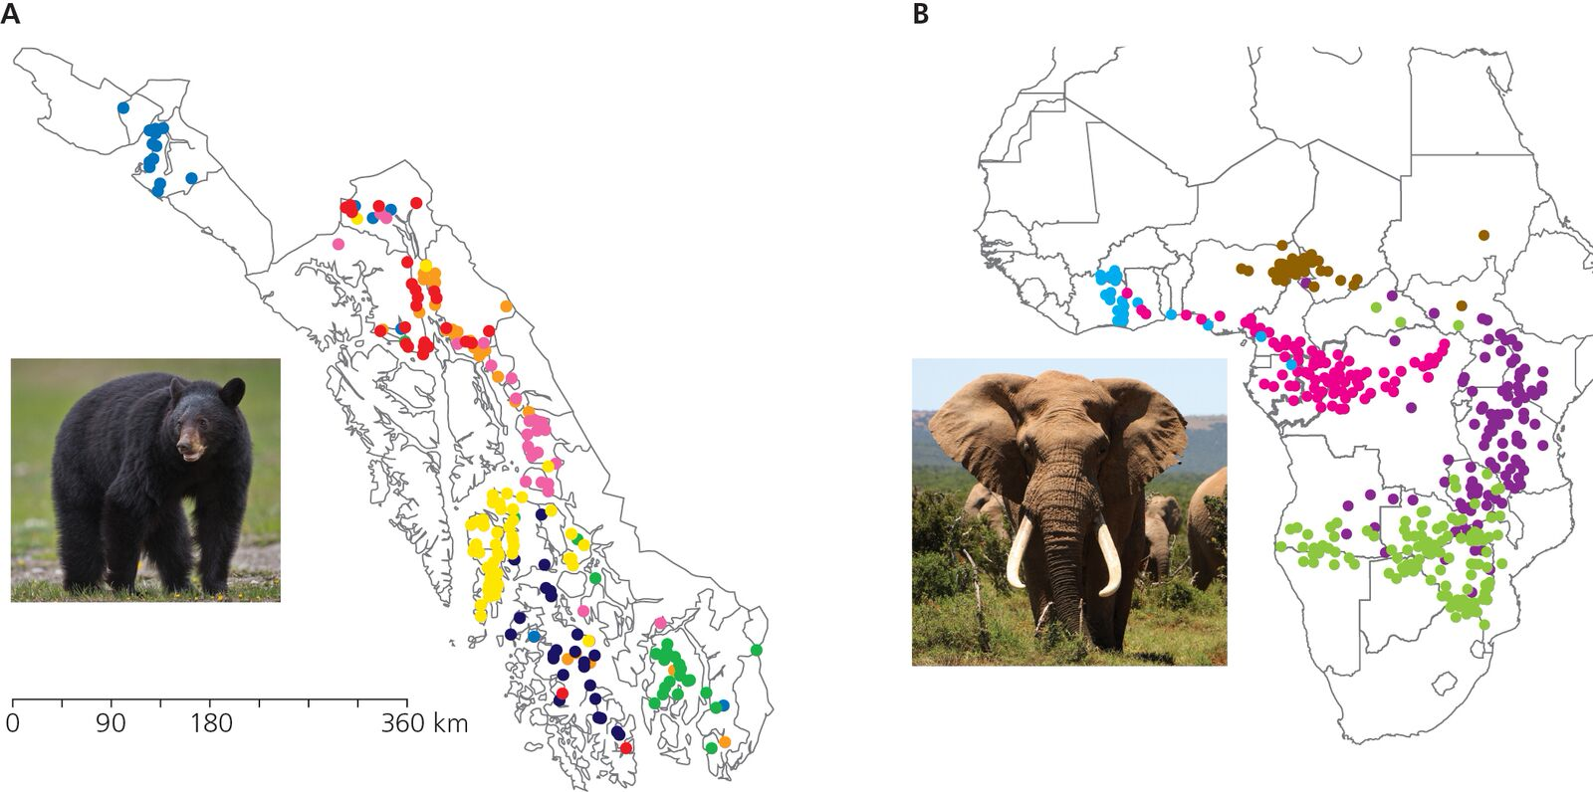
Subdivided populations show distinct genetic structure
Black Bears in SE Alaska
African Elephants

Slide 39
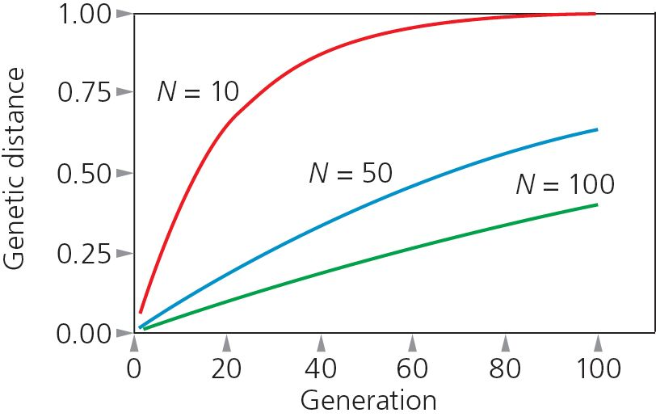
Isolated populations become genetically distinct

Slide 40
Methods to detect population differentiation and gene flow

Slide 41
Measuring genetic differentiation among populations
Useful to partition genetic variation into components:
within populations
between populations
among populations
Sewall Wright’s Fixation index (F_{ST}) is a useful index of genetic differentiation and comparison of overall effect of population substructure
Measures reduction in heterozygosity (H)

Slide 42
Measuring genetic differentiation among populations
Useful to partition genetic variation into components:
within populations
between populations
among populations
Sewall Wright’s Fixation index (F_{ST}) is a useful index of genetic differentiation and comparison of overall effect of population substructure
Measures reduction in heterozygosity (H)
F_{ST} ranges between minimum of 0 and maximum of 1:
= 0 ⇒ no genetic differentiation
<< 0.5 ⇒ little genetic differentiation
>> 0.5 ⇒ moderate to great genetic differentiation
= 1.0 ⇒ populations fixed for different alleles
H_{Total} - H_{subpopulation}
F_{ST}=
H_{Total}

Slide 43
Consider three subpopulations with 2 alleles at frequencies p and q,
p q H_{S}=2pq
Subpop 1: 0.7 0.3 0.42
Subpop 2: 0.5 0.5 0.50
Subpop 3: 0.3 0.7 0.42
Average H_{S} = 0.446

Slide 44
The total expected heterozygosity (H_{T}) across all subpopulations is calculated from the average allele frequency
p q
Subpop 1: 0.7 0.3
Subpop 2: 0.5 0.5
Subpop 3: 0.3 0.7
p = 0.5 q = 0.5
Remember that,
H_{T}= 2pq = 0.5
H_{Total} - H_{subpopulation}
F_{ST}=
H_{Total}
0.5 – 0.466
F_{ST}=
= 0.11
0.5

Slide 48
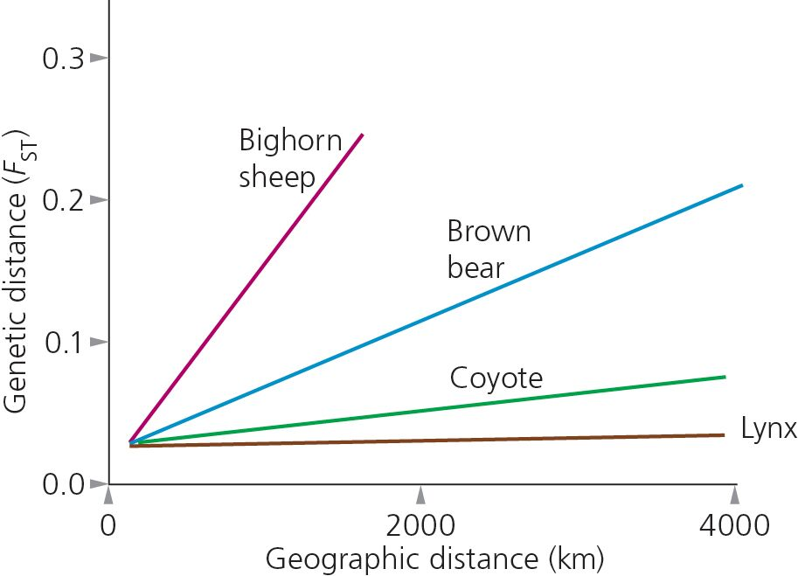
Amount of gene flow varies with the biology of the organism

Slide 49
Demographic Inference Methods
Many approaches!
My overview will be somewhat selective and historical
See Schraiber and Akey (2015) Nat Rev Genet for a recent review
See also
http://methodspopgen.com/methods-to-infer-population-structure/

Slide 50
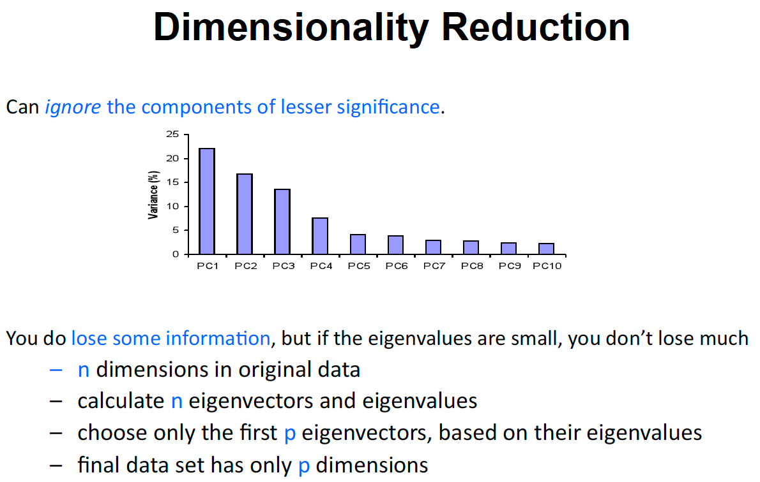
Notes:
Principal Components • First principal component is the direc8on of greatest variability (covariance) in the data • Second is the next orthogonal (uncorrelated) direc8on of greatest variability – So first remove all the variability along the first component, and then find the next direc8on of greatest variability

Slide 51
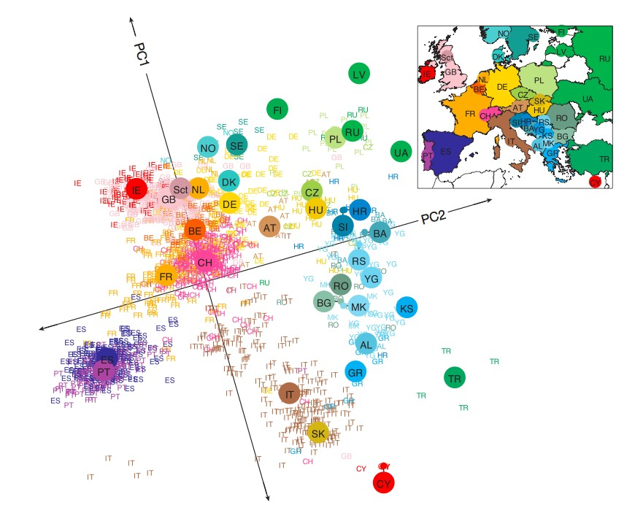
PCA of Europeans
Novembre et al. 2008 Nature
Notes:
e The top principal components are viewed as continuous axes of variation that reflect genetic variation due to ancestry in the sample.
e Individuals with similar values for a particular top principal component will have similar ancestry for that axes.
e A application of principal components to genetic data from European samples (Novembre et al., Nature 2008) showed that among Europeans for whom all four grandparents originated in the same country, the first two principal components computed using 200,000 SNPs could map their country of origin quite accurately in the plane

Slide 52
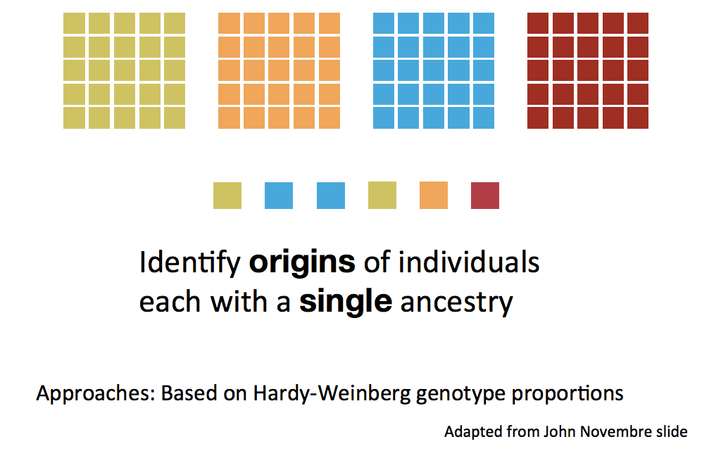
Mixture Model

Slide 53
Admixture Model
Several recent and ongoing genetic studies have focused on admixed populations: populations characterized by ancestry derived from two or more ancestral populations that were reproductively isolated
Admixed populations have arisen in the past several hundred years as a consequence of historical events such as the transatlantic slave trade, the colonization of the Americas and other long-distance migrations

Slide 54
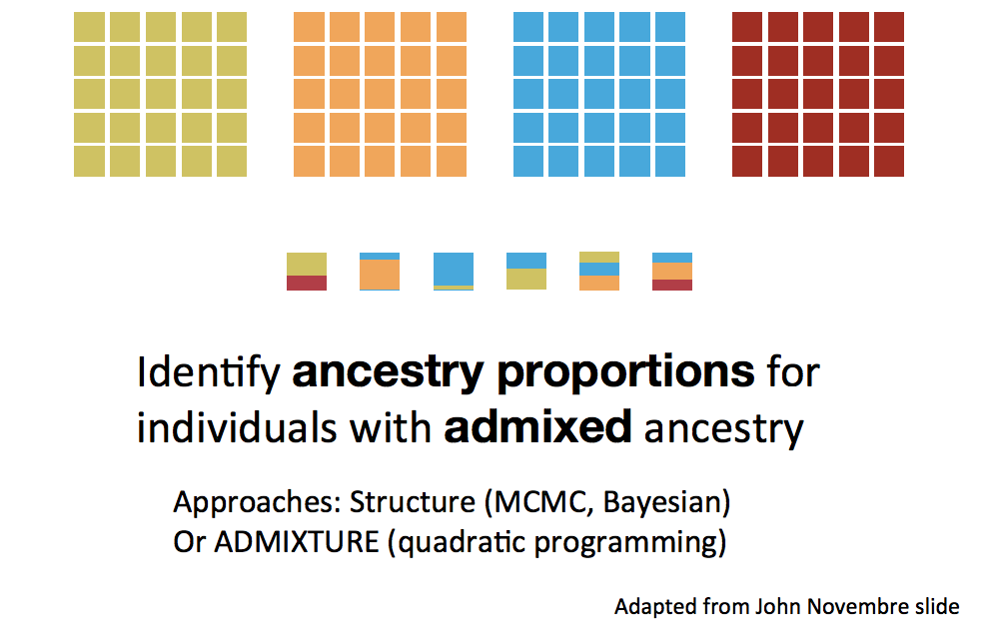
Admixture Model

Slide 55
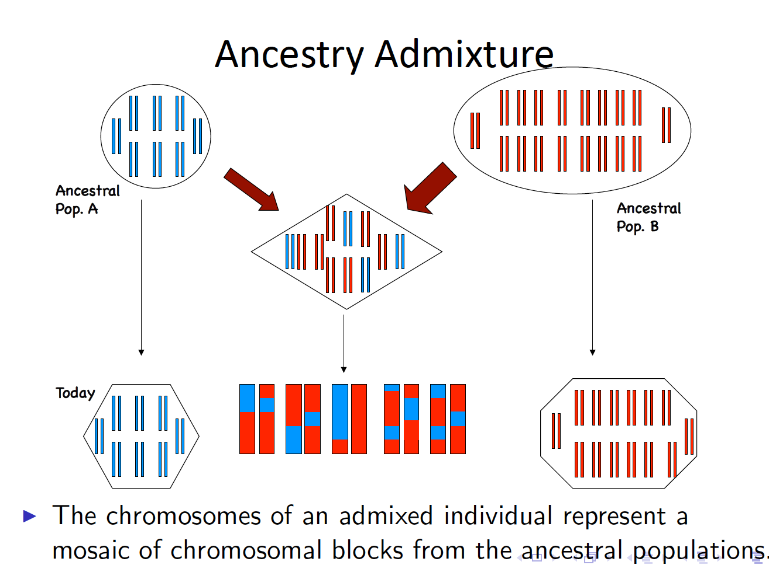

Slide 57
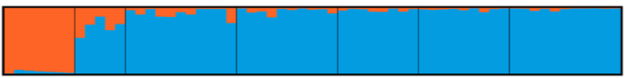
10,059 SNPs
Probability of Membership
La Caleta
Tres
Palmas
PNNE
Mona
Desecheo
La Parguera
Culebra
Notes:
The microsatellite data fails to recover any genetic differentiation among populations.
However the more comprehensive SNP data suggest a genetic break within the Dominican Republic. Slightly different than genetic break found for Acropora Palmata and gobies which are in the Mona Passage.

Slide 58
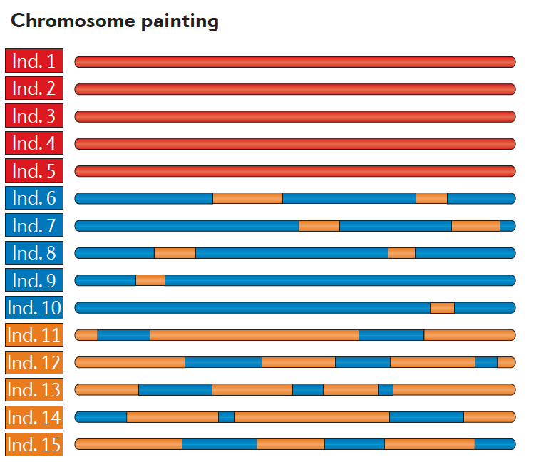
FineSTRUCTURE, HapMix, Globettroter
Schraiber and Akey (2015) Nat Rev
Notes:
The microsatellite data fails to recover any genetic differentiation among populations.
However the more comprehensive SNP data suggest a genetic break within the Dominican Republic. Slightly different than genetic break found for Acropora Palmata and gobies which are in the Mona Passage.

Slide 59
Methods to estimate migration

Slide 60
RELATIONSHIP BETWEEN F_{ST} AND Nm IN THE ISLAND MODEL
Nm is the absolute number of migrant organisms that enter each subpopulation per generation
Hartl and Clark. 1997. Principles of Population Genetics. Sinauer Assoc.

Slide 61
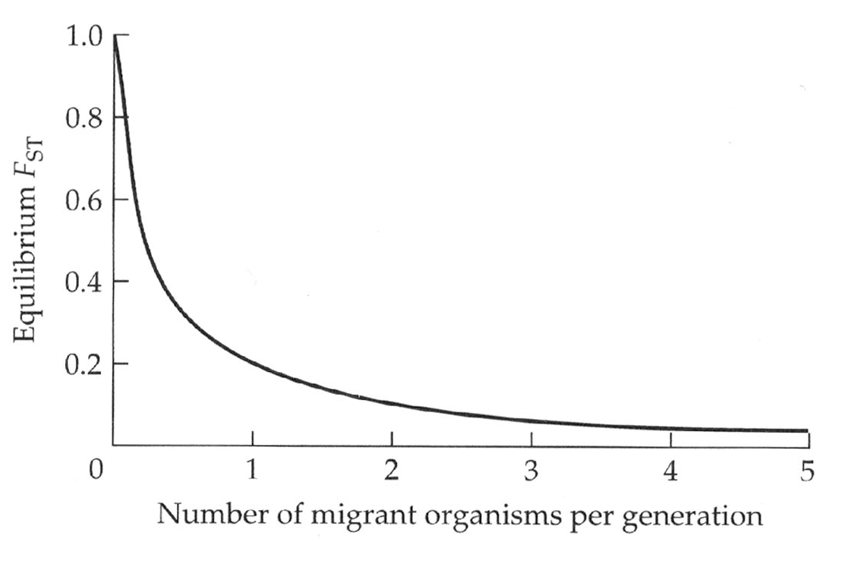
RELATIONSHIP BETWEEN F_{ST} AND Nm IN THE ISLAND MODEL
Nm is the absolute number of migrant organisms that enter each subpopulation per generation
Hartl and Clark. 1997. Principles of Population Genetics. Sinauer Assoc.

Slide 62
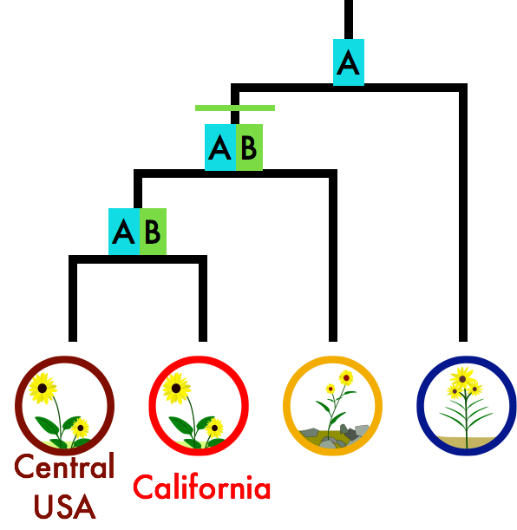

ABBA-BABA test
H. bolanderi
H. annuus
Outgroup
Notes:
62
Which direction?

Slide 63
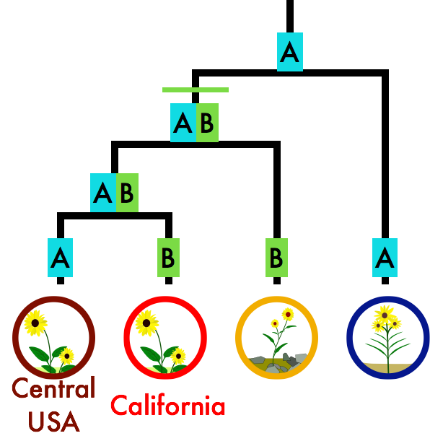
ABBA-BABA test
ABBA-BABA test
H. bolanderi
H. annuus
Outgroup
Notes:
63
Which direction?

Slide 64
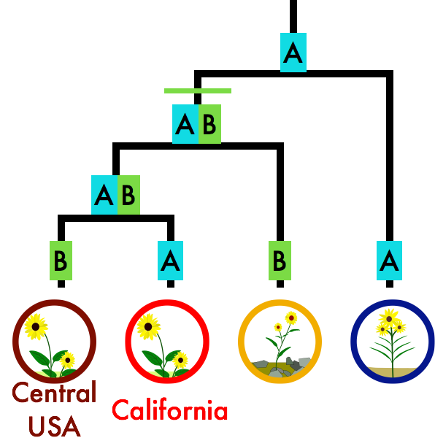
ABBA-BABA test
ABBA-BABA test
H. bolanderi
H. annuus
Outgroup
Notes:
64
Which direction?

Slide 65
ABBA-BABA test
ABBA-BABA test
D-statistic = #ABBA - #BABA
Neutrality: D = O
Gene flow: D = +
Notes:
65
Which direction?

Slide 66
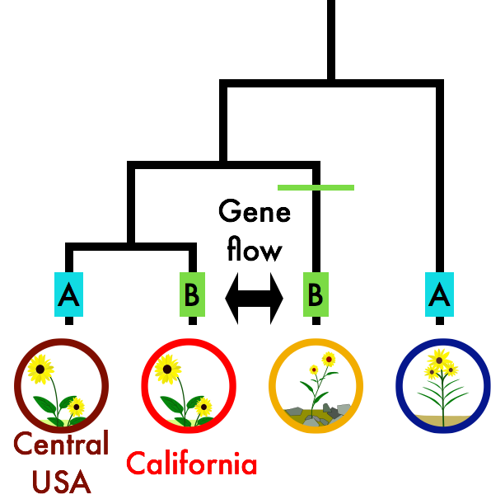
ABBA-BABA test
More ABBA under gene flow
H. bolanderi
H. annuus
Outgroup
Notes:
66
Which direction?

Slide 67
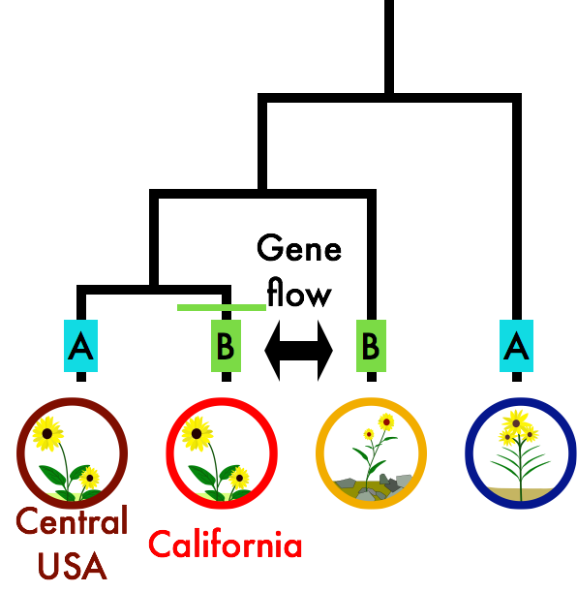
ABBA-BABA test
More ABBA under gene flow
H. bolanderi
H. annuus
Outgroup
Notes:
67
Which direction?

Slide 68
ABBA-BABA test
More ABBA under gene flow
H. bolanderi
H. annuus
Outgroup
Notes:
68
Which direction?

Slide 69
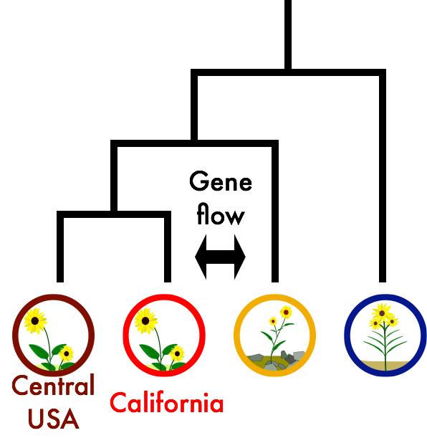
D statistic = 0.123 ± 0.033
ABBA > BABA
6-8% of the genome introgressed
H. bolanderi
H. annuus
Outgroup
Notes:
69
Which direction?

Slide 70
Methods to estimate both
structure and migration

Slide 71
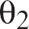
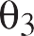
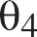
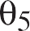
IM/IMa/IMa2
Uses coalescent simulation to calculate the full likelihood of the data given the model, for non-recombining regions (mitochondria,Y chromosome, small autosomal regions).
Bayesian inference based on MCMC walk through parameter space, can be computationally expensive.
Handles arbitrary number of populations.
Hey and Nielsen (2004) Genetics
Hey (2010) Mol Biol Evol

Slide 72
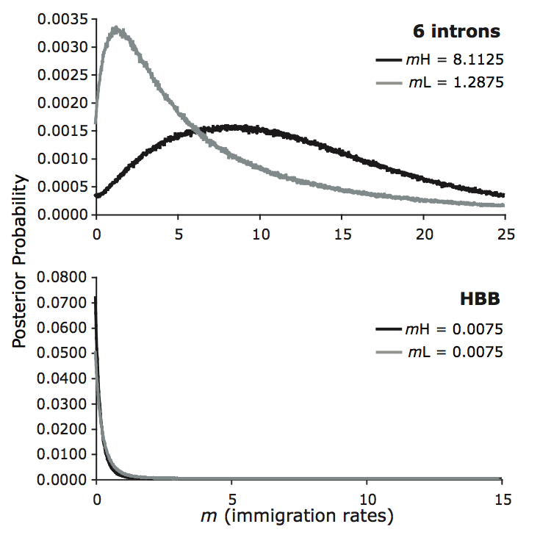
High F_{ST} = 1.00 results in zero migration rate for the β-globin locus but not other loci.
Bulgarella et al. (2012) showing inter-locus contrasts of migration rates in Crested Duck.

Slide 73
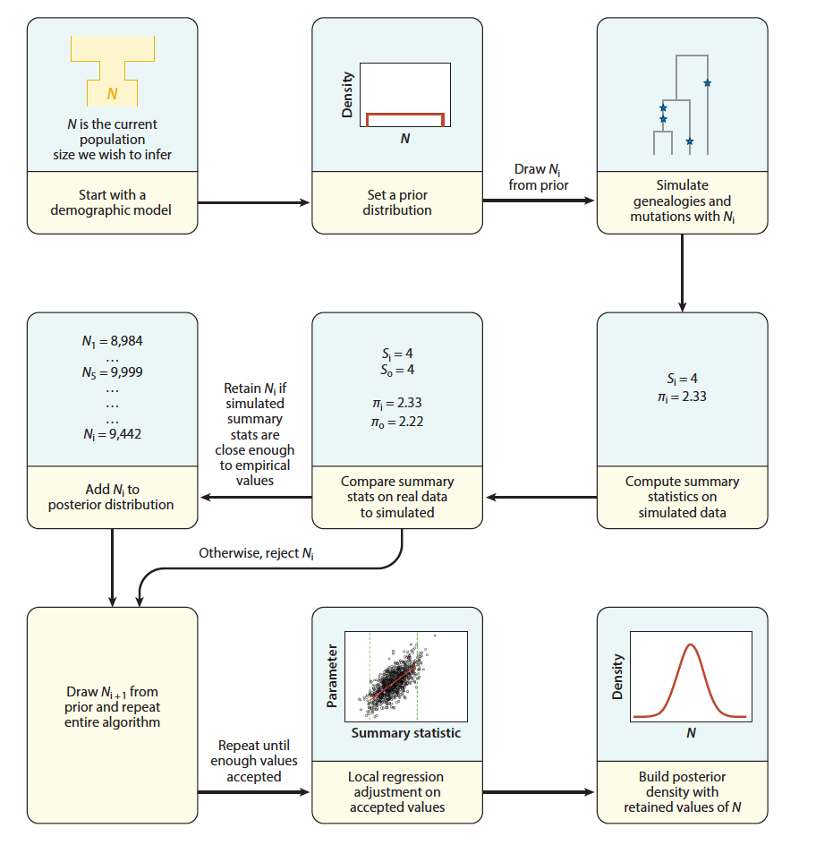
Approximate Bayesian computation

Slide 74
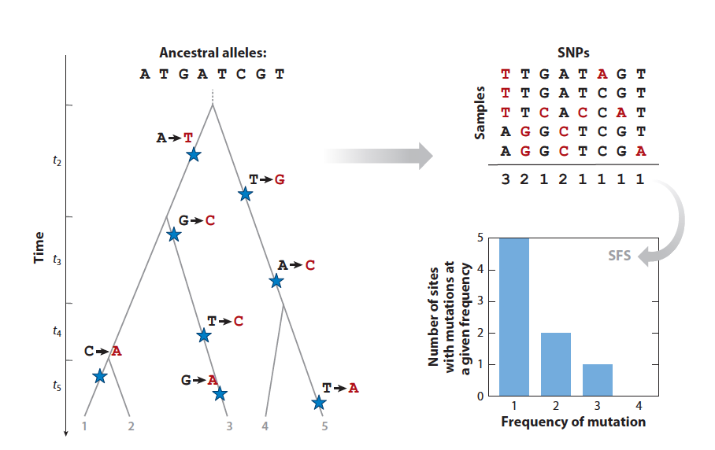
Allele Frequency Spectrum

Slide 75
Allele Frequency Spectrum

Slide 76
Allele Frequency Spectrum
Beichman et al. 2018 Annu. Rev. Ecol. Evol. Syst. 2018

Slide 77
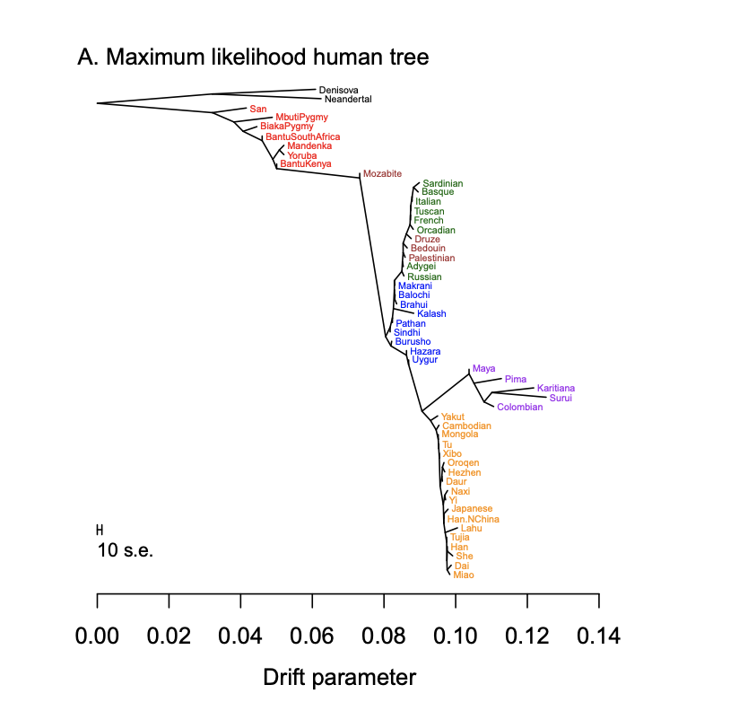
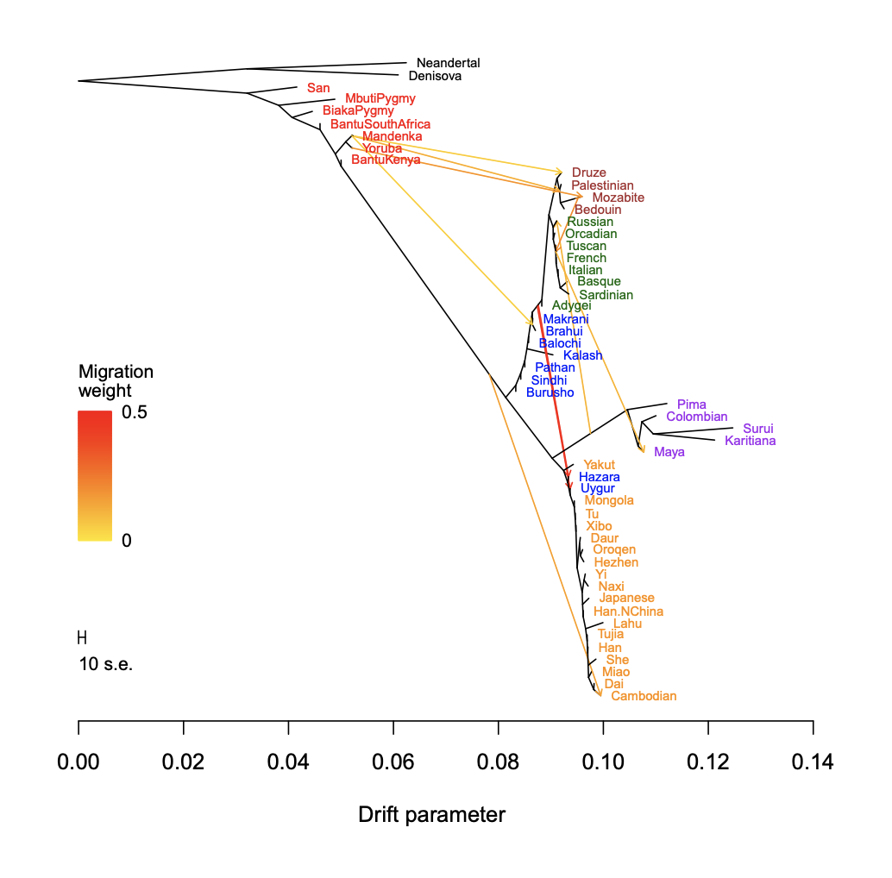
TreeMix:
Structure with migration bands

Slide 78
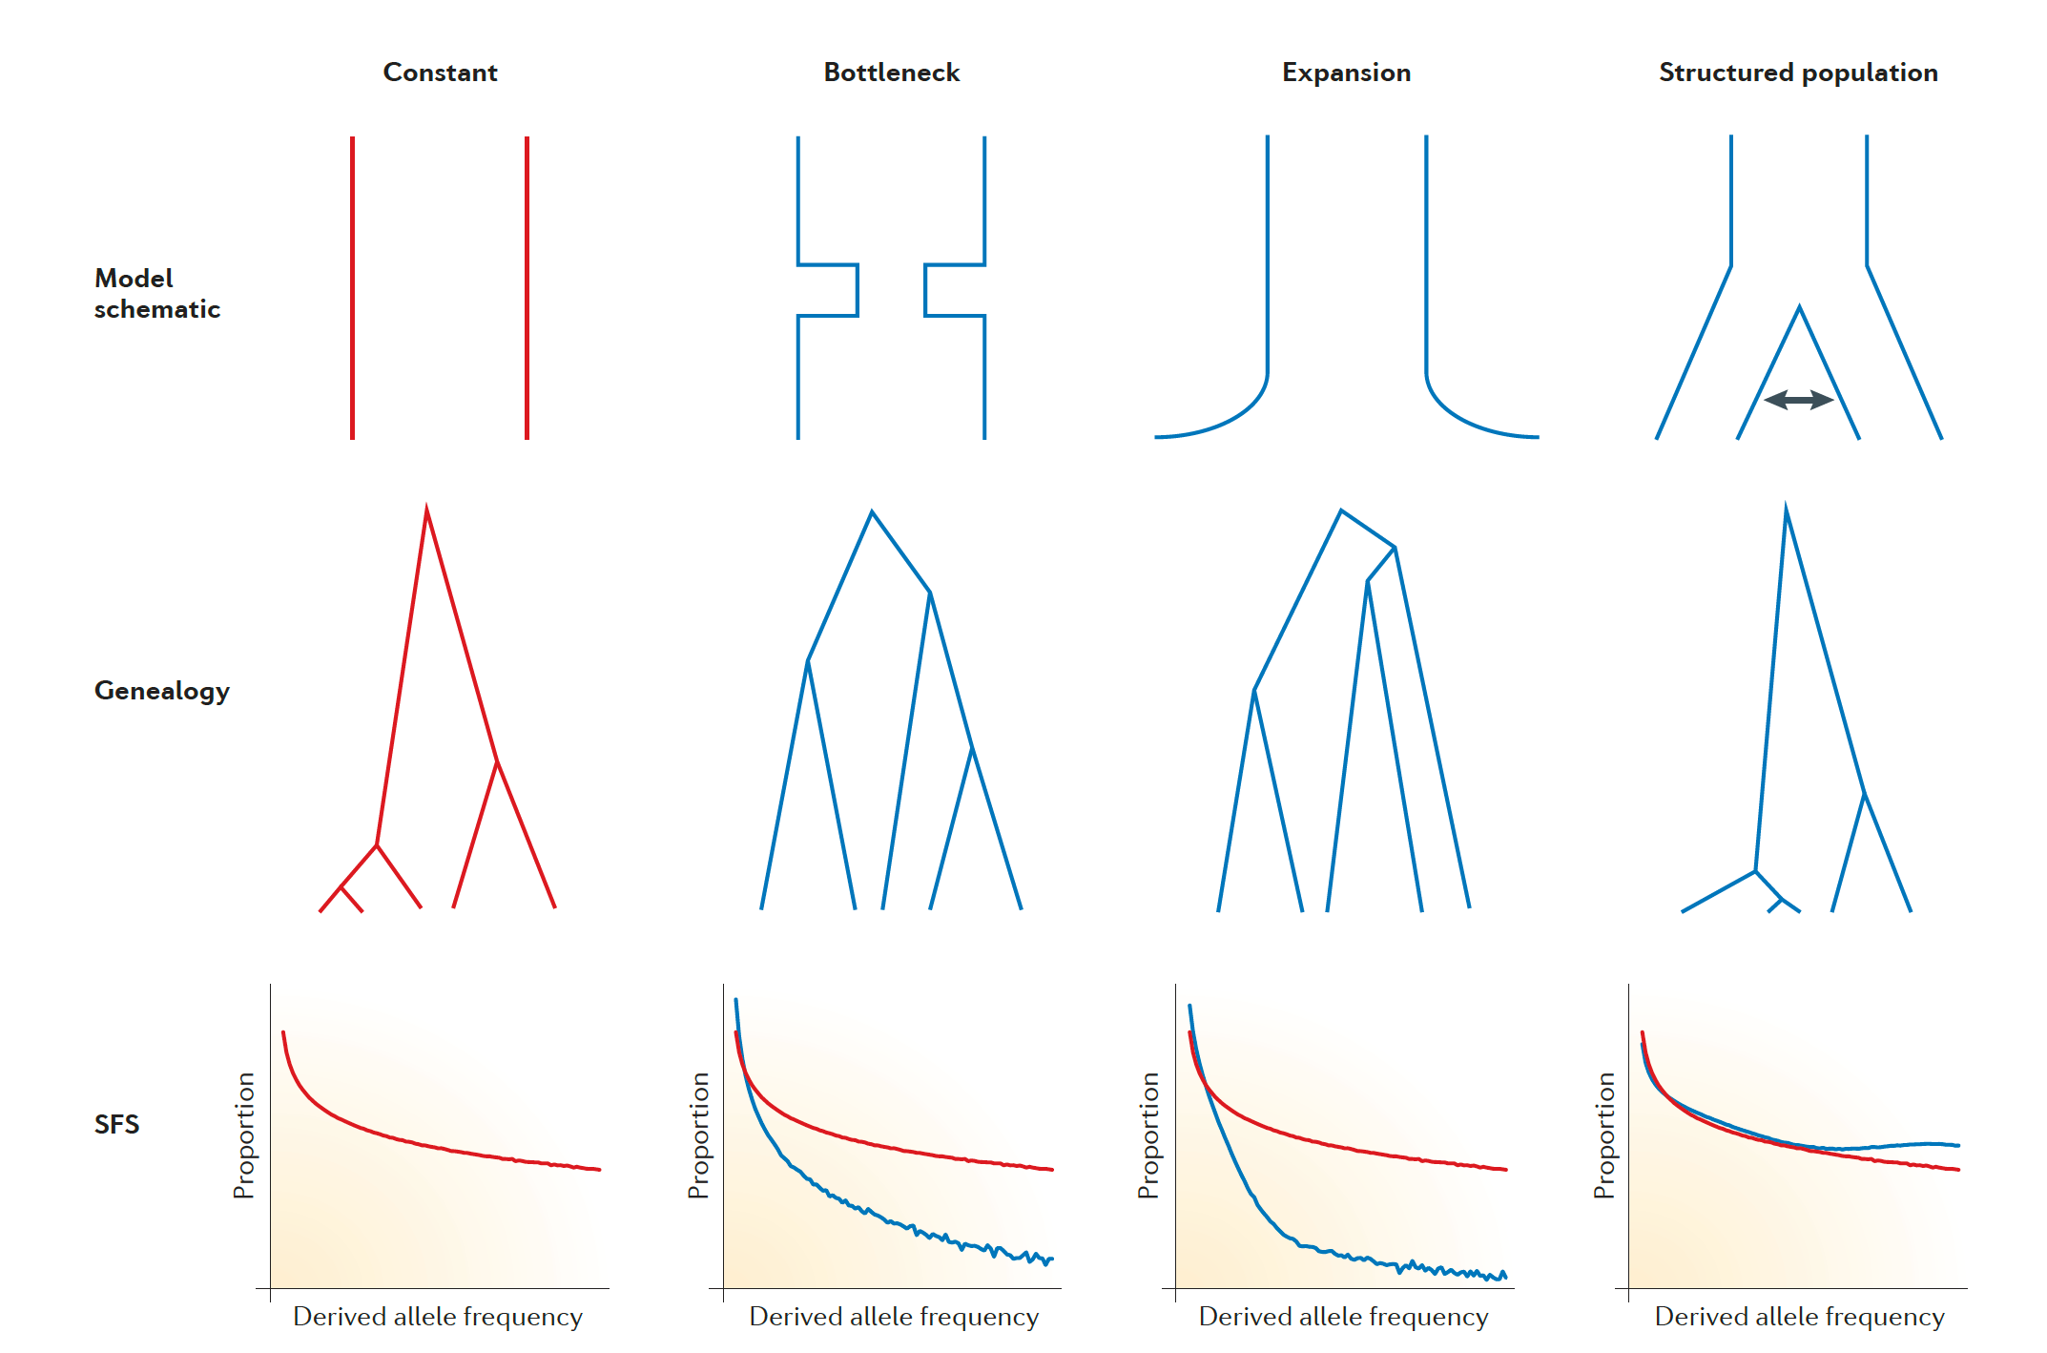
Allele Frequency Spectrum
Schraiber and Akey (2015) Nat Rev Genet
Notes:
In a population of constant size (the Standard Neutral Model), expectation number of SNPs at frequency i is proportional to 1/I
Population growth creates an excess of low-frequency alleles
Commonly quantified by Tajima’s D.

Slide 79
Model based methods
Model based methods
Collect data
Develop models of evolution
Calculate likelihood support for models based on your data
Notes:
79

Slide 80
Model based methods
Model based methods
Collect data
Develop models of evolution
Calculate likelihood support for models based on your data
Pick best supported model
Notes:
80

Slide 81
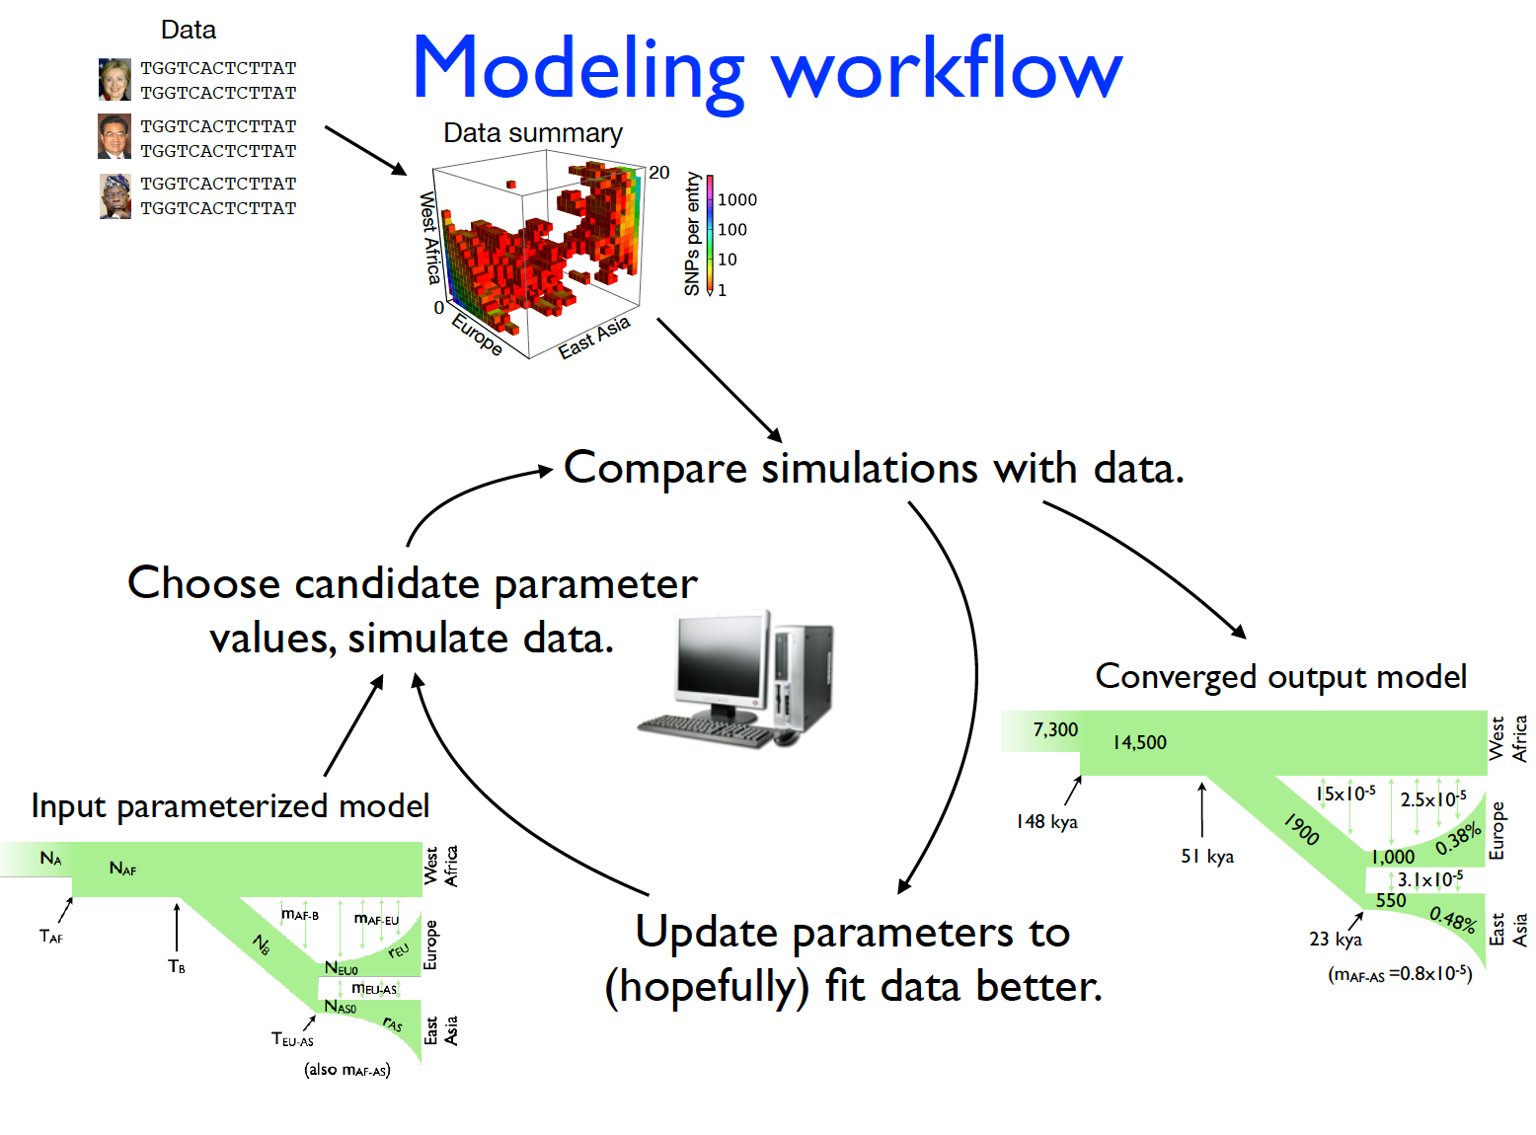
∂a∂i
fastsimcoal2
Gutenkunst et al.
PLoS Genet (2009)

Slide 82
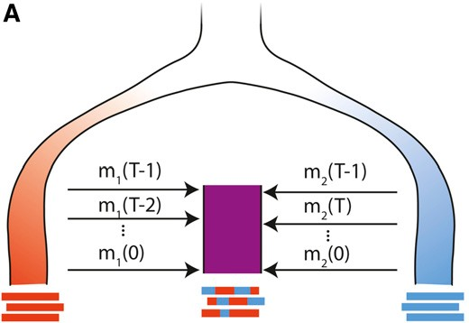
Haplotype lengths
The genomes of admixed individuals will be mosaics of the source populations
As time passes since admixture, recombination breaks up admixture tracts
TRACTS Infers admixture times (potentially multiple pulses) and proportions from the spectrum of haplotype lengths
Gravel et al.
Genetics (2012)

Slide 83
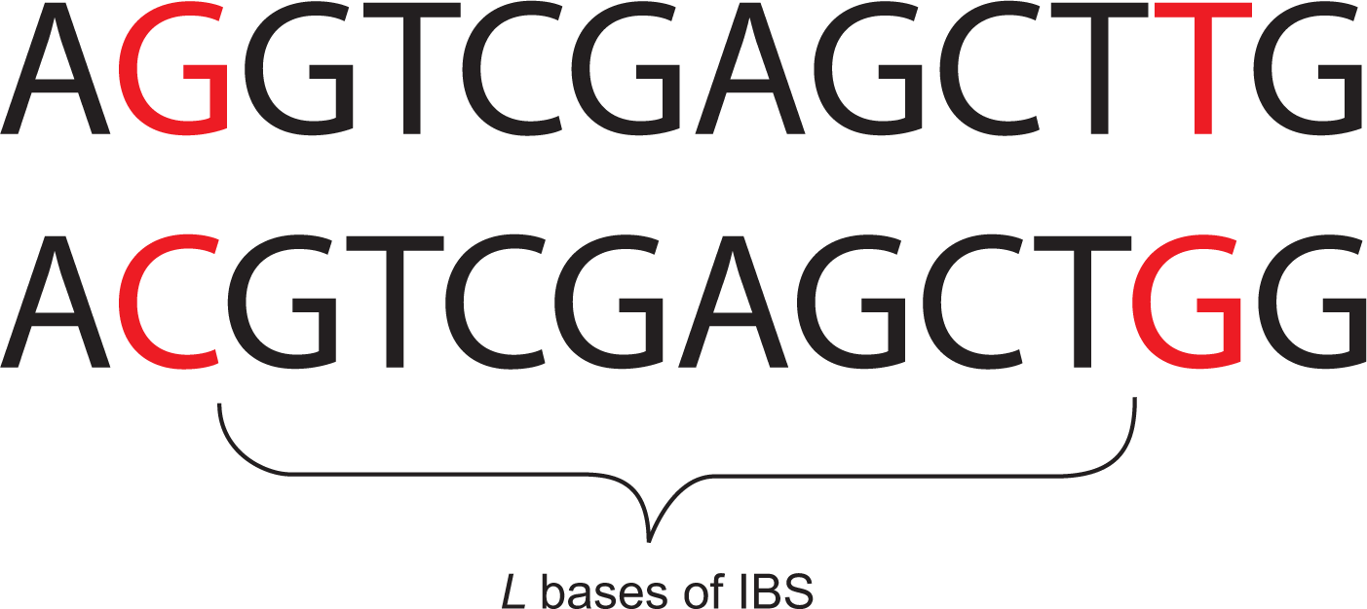
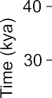
Sequences that are Identical By State (IBS) with and between populations are informative about demographic history
Calculate expected spectrum of IBS tract lengths using coalescent theory
Can fit very complex models
Harris and Nielsen (2013) PLoS Genet

Slide 84
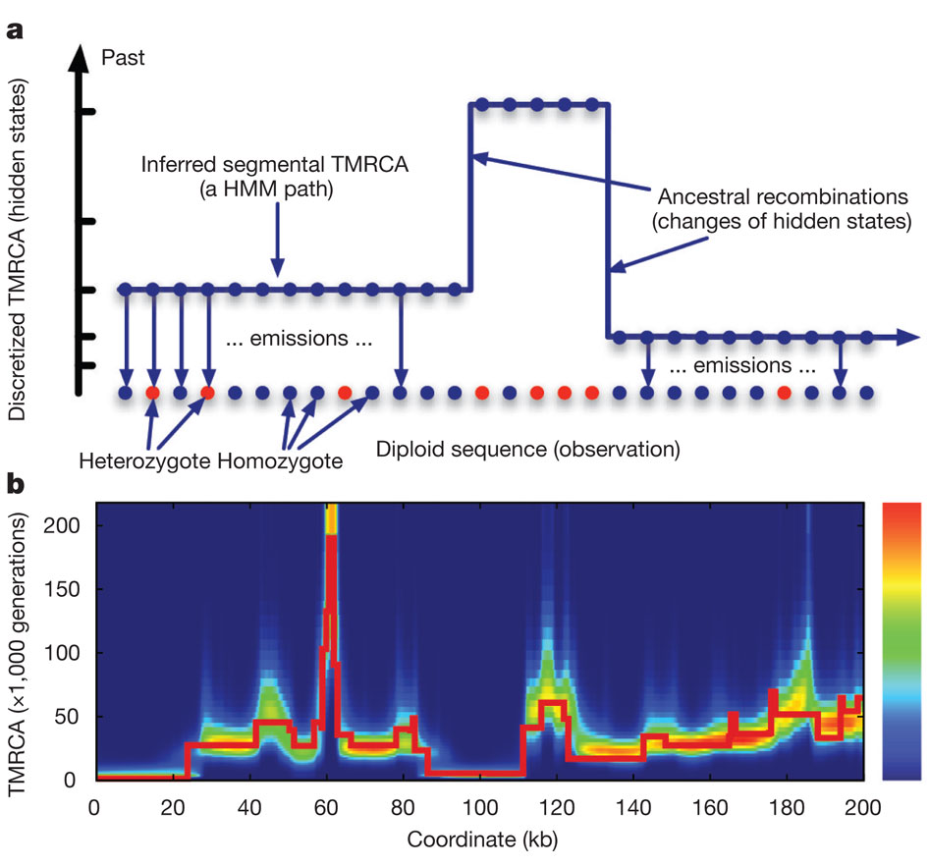
We can infer population sizes using genetic variation across the genome
Inferred segmental track
Ancestral
recombination
Time
Genetic variant
Time
Position across the genome (kb)
Li and Durbin 2011 Nature 475
Notes:
Pairwise sequencially markovian coalescent

Slide 85
PSMC
Effective population size (x10⁴)
a
5
YRI1.A YRI2.A EUR.1.A[0.29]
EUR2.A
4
KOR.A[0.10]
CHN.A[0.05]
3
2
1
0
10⁴
10⁵
10⁶
10⁷
Estimate effective population size over time from a single unphased genome.
No parametric model (e.g. exponential growth) assumed.
Li and Durbin (2011) Nature
Notes:
Pairwise Sequentially Markovian Coalescent

Slide 86
MSMC
Effective population size
Relative cross coalescence rate
1.0
0.8
10
5
0.6
10⁴
0.2
0
10³
10⁴ 10⁵
Time (years ago)
10⁶
10³ 10⁴
10⁵
Time (years ago)
SMC model for multiple phased sequences
Inferences of population sizes for more recent times than PSMC.
Inferences of cross-coalescent rates between populations, which are indicative of population divergence and migration.
Schiffels and Durbinn Nature Genet (2014)

Slide 87
For Tuesday we will be discussing: Moreno-Mayar et al. 2018 and Rougemont et al. 2018

